Slide 1
Minimum Performance Standard Testing for Halon Replacement
Test Cell Design
Not subject to US Export Administration Regulations (EAR), (15 C.F.R. Parts 730-774) or US International Traffic in Arms Regulations (ITAR), (22 C.F.R. Parts 120-130).
Boeing: John Vance, George McEachen, Pat Baker, David Shaw, John Hazen, John Jaquish, Howard Himeno, Ryan Wilson, Jeffrey Erickson and
Nels Olson (corresponding author and today’s presenter)
FAA: Dhaval Dadia, Rick Whedbee, Louise Speitel
Month Day^{th}, 2019

Slide 2
Boeing Cargo MPS Test Cell Development
Development of Boeing’s Cargo MPS Cell, included key design features to satisfy requirements in each of the following tests:
Empty compartment concentration setting
Aerosol can burst simulation test
Jet A pan fire test
Bulk load fire test
LD-3 containerized fire test
To achieve the goals of the MPS chamber design in the context of the international community that wrote the MPS document, the team:
Scrupulously modeled and document each design feature
Reported the details of those designs to FAA to build consensus
Confirmed the quality of the data with the FAA MPS Task Group
Cooperative Development Leads to Success

Slide 3
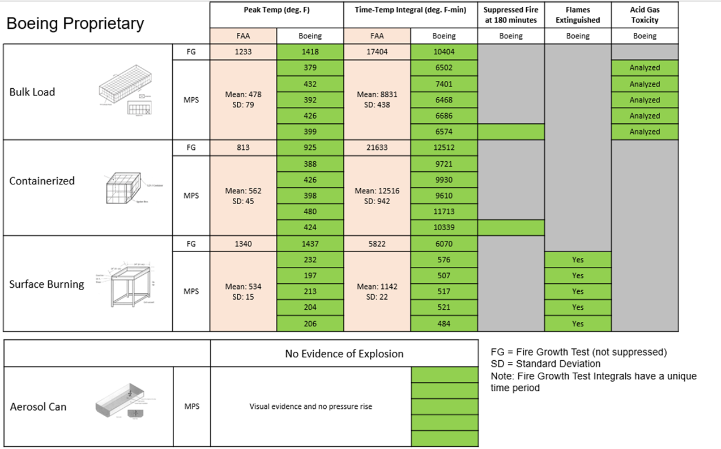
Four Test Protocols Covered by the MPS
All Tests:
To collect the maximum-temperature and time/temperature integral data required a tightly sealed and well controlled chamber.
Bulk Load Fire:
173 cardboard boxes filled with shredded paper
Containerized Fire:
33 cardboard boxes filled with paper in a cargo container
Surface Burning Fire:
Jet A with added gasoline to allow for easier ignition
Aerosol Can Explosion Simulation:
Propane, denatured alcohol and water at 240 PSI exhausted into a the chamber across an active ignition source
Minimum Performance Standard for, Aircraft Cargo Compartment Halon, Replacement Fire Suppression Systems (2012 Update), John W. Reinhardt, May 2012, DOT/FAA/TC-TN12/11
Fuel, Ignition, Oxygen Supply and Suppression Agent All Controlled

Slide 4

Driver: Peak and Time-Temperature Integral
T₁
T₂
T₃
T₄
Test window is 28 minutes for Bulk and Containerized and 3 minutes for surface burning fire
T₁ = one thermocouple goes above 200 °F
T₂ = T₁ + 1 minute = Agent
T₃ = T₂ + 2 minutes = Integ.
T₄ = T₃ + 28 minutes = End
Temperature, °F
Ignition
Time, minutes

Slide 5
MPS Test Cell Geometry
Cargo Bay Structure
Total Weight: 13,600 lbs
92” wide doors
on Both ends
66”
319 ⁵/16”
I-Beam Structure
Total Weight 4400 lbs
164”
Designed, Documented and Purpose Built System

Slide 6
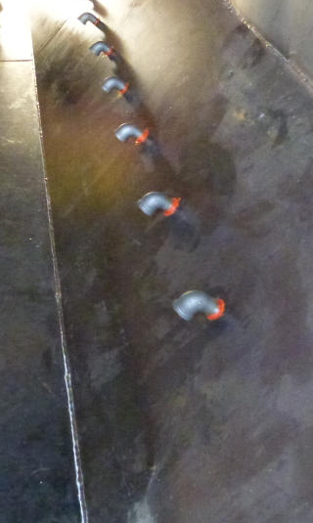
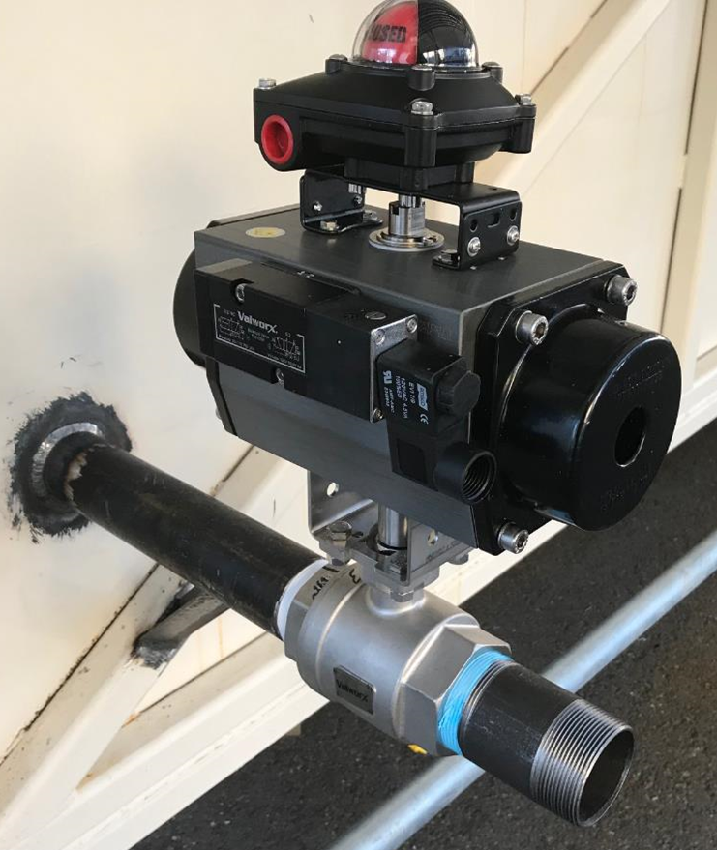
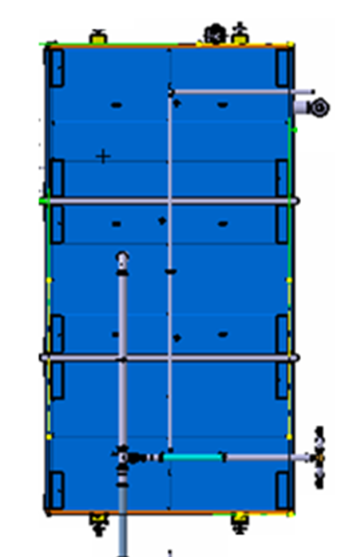
Chamber Air Inlet Plenum and Penetrations
Inlet air valves at each corner of the chamber ensure emergency air shutoff capability
Air is distributed evenly throughout the chamber from the triangular plenums via multiple iron elbows
50 CFM Outlet

Slide 7
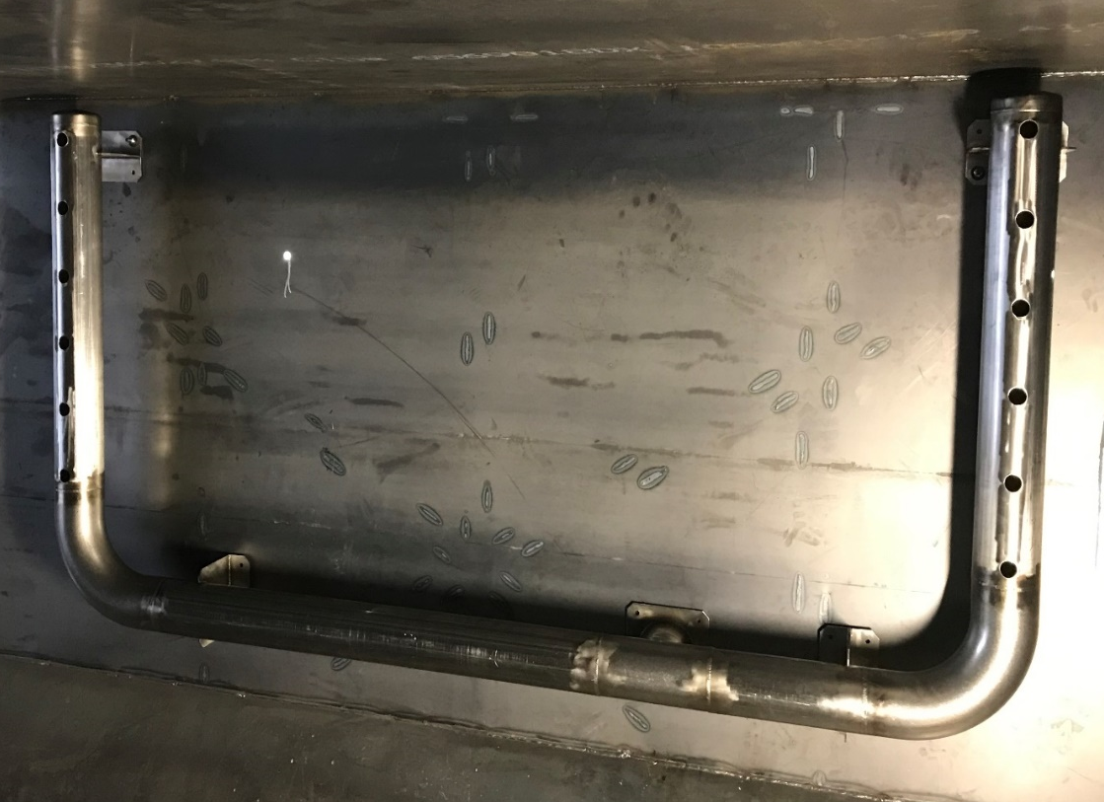
U-Tube Collects Air Extracted at 50 CFM from the Chamber
To collect air during a fire and send it to the scrubber system at 50 CFM, this U-Tube was designed
We have achieved tighter air flow control than is required by the MPS
At the base of the U there is a four inch tube that extends through the wall of the chamber
Outside, it joins a cooling loop that cools the gases and allows large ash particles to settle out
Airflow through the chamber needs to be tightly controlled

Slide 8
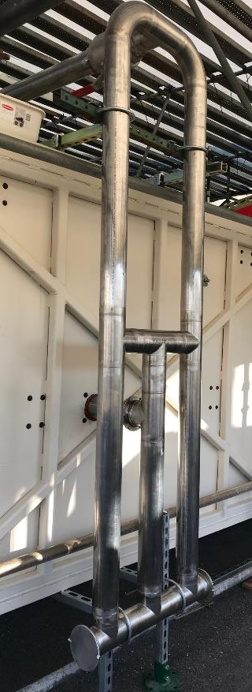
Cooling and Particulate Scrubbing Loop
Air in the chamber can reach 1600 °F
Cooling the flow and removing large scale particulate contamination is achieved via the structure pictured at right
The flow is split to increase surface area and allow cooling
The downward legs allow ash to settle out of the hot air flow before it reaches the horizontal tubing runs across the top of the chamber

Slide 9
MPS Chamber Air Flow Control System
High Flow Bleed Air Inlet
Fine Flow Control Metering Valve
Gross Flow Metering Valve
Low Flow Bleed Air Inlet for Fine Adjustment of Flow
50 CFM from Chamber
Flow to 15,000 CFM
Limestone Fluidized Bed Chemical Scrubber System
Pitot Tube Flow Monitoring Device
High Flow
Chamber Evacuation Valve
200-600 CFM Evacuation Flow from Chamber
Notes:
High flow rapid evacuation for fast turn around

Slide 10
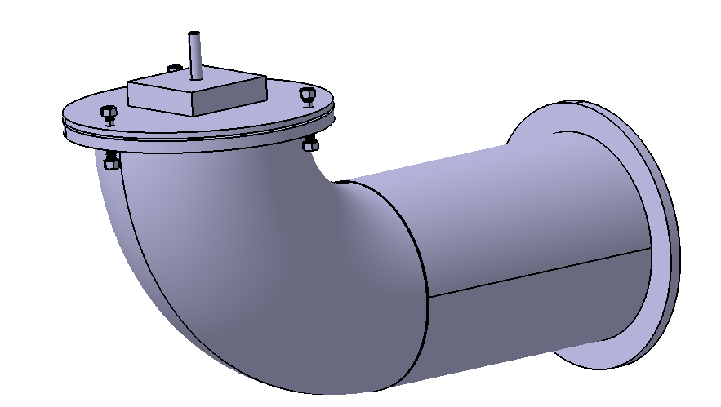
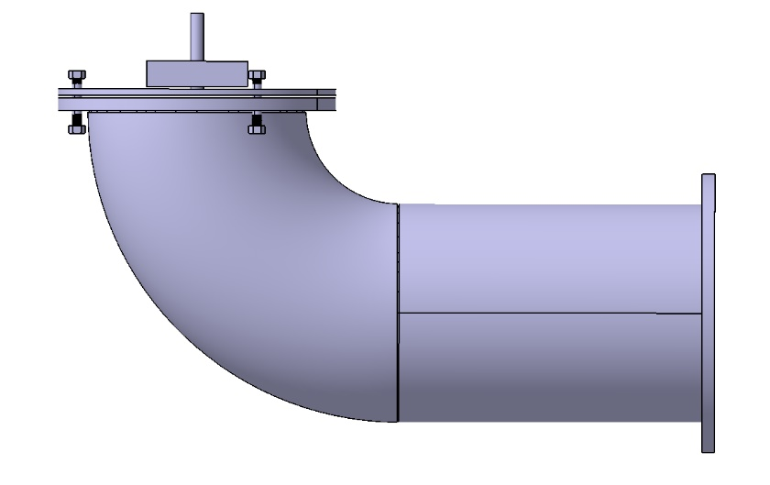
MPS Chamber Over Pressure Protection
Rapid expansion in the chamber is allowed to escape as the Adjustable-Mass-Lid rises
Bolt pins keep the lid aligned with the base plate and allow it to close once the instantaneous pressure wave subsides
Adjustable Mass Lid
Base Plate

Slide 11
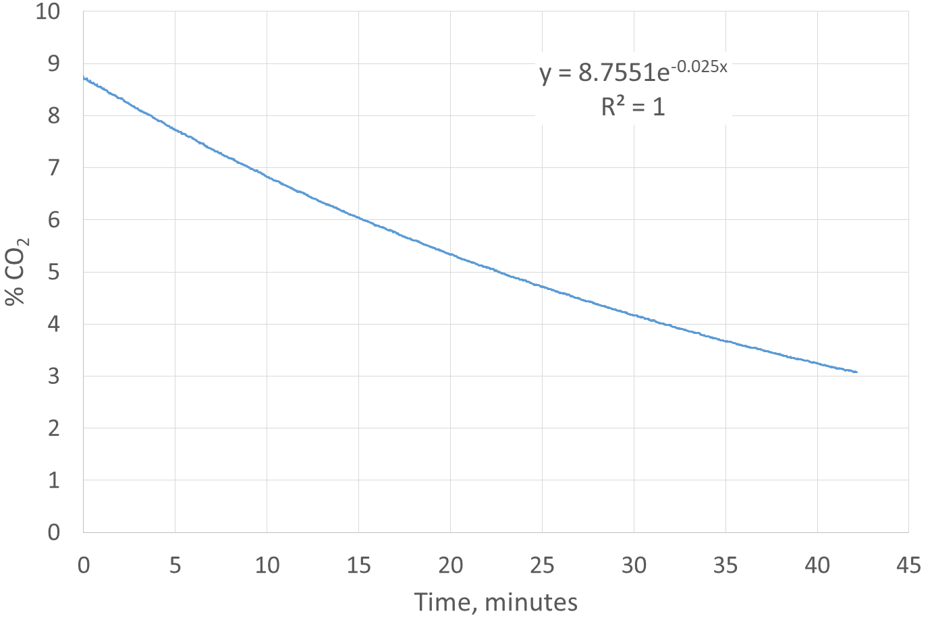
Well Controlled Chamber Air Exchange Rate
y = 8.76 e^{-0.025x}
R² = 1
Using the coefficient of the exponent times the volume of the chamber (2,000 ft³) we get our flow rate of 50 ft³ / minute

Slide 12
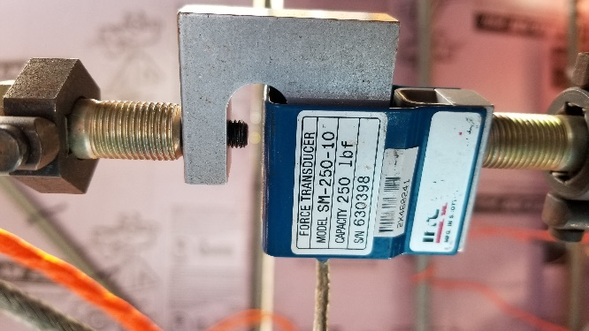
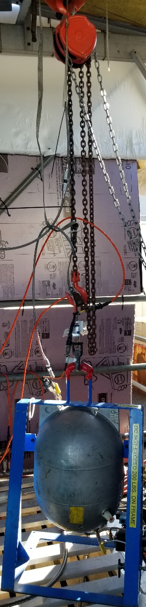
Halon 1301 and CF₃I Delivery Mass Flow Rate
Monitoring the delivery of suppression agent is essential to understanding the effectiveness of the agent
Of particular importance is the ability to measure mass flow rate during low rate discharge
Each vessel is suspended from a load cell which then is monitored during discharge and the signal converted to a mass flow rate parameter
Mass flow can then be compared against percent concentration for the agent and of course the imposed 50 CFM air exchange rate

Slide 13
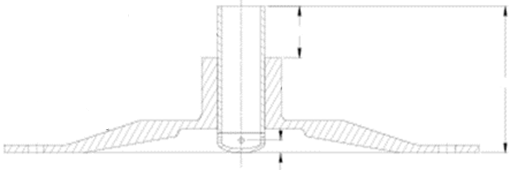
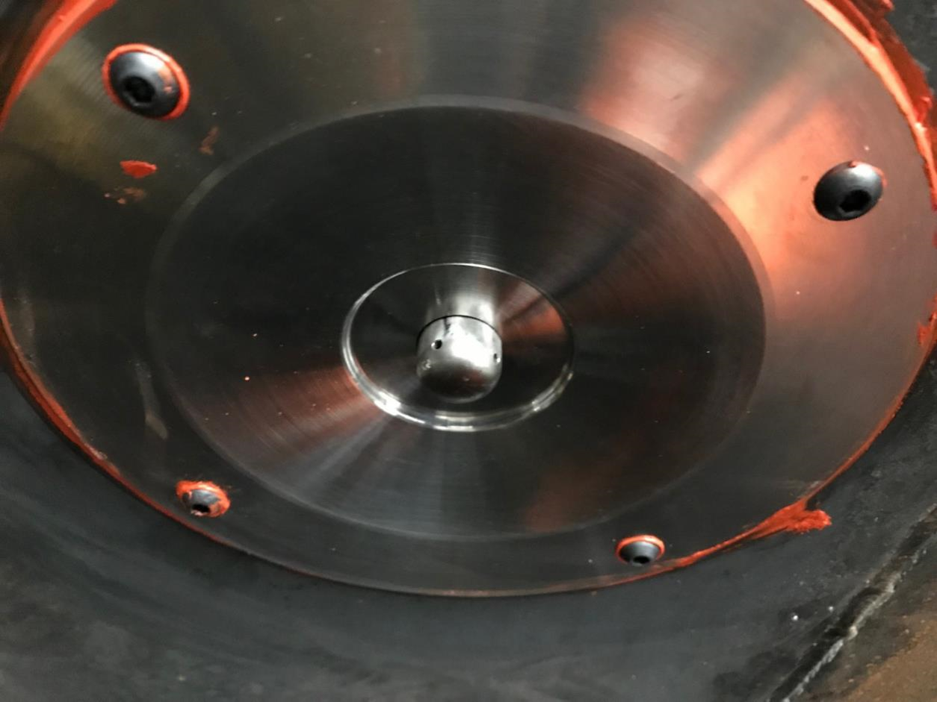
Halon 1301 and CF₃I Delivery Nozzles
Halon 1301 and CF₃I distribution is provided by four nozzles fitted into flow pans on the ceiling of the chamber
Optimization of back-pressure, orifice size and impingement geometry ensures proper vaporization

Slide 14

Sensor Coverage for MPS the Chamber
35 Thermocouples are distributed across the ceiling and walls of the MPS chamber
All thermocouple and pressure sensor signal cables are shielded and isolated in separate wiring trays
All valve control and other power cables are in a second set of wiring trays
All ancillary equipment is protected by thermocouple monitors
All chamber operations are monitored by both IR and standard optical 30 frame per second cameras
All high speed operations are monitored at 240 frames per second e.g., during aerosol can simulation testing
All pressure sensors are monitored at 3000 Hz in cases where high frequency pressure waves are a potential outcome

Slide 15
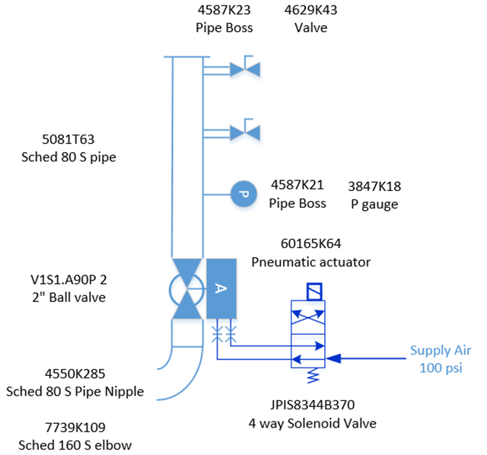
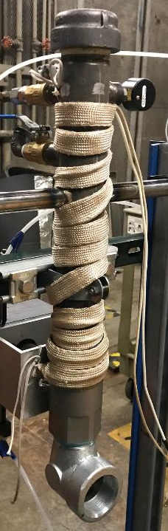
Aerosol Can Burst Simulator Design
Notes:
By insulating the apparatus and maintaining tight control of the pressure in the aerosol can simulator we are able to remove a critical timing component from the experimental process. We maintain pressure within one PSI of the designated pressure while the concentration of agent is decaying. Once the minimum desired concentration is reached, the aersol can simulator is activated and its contents are exhausted into the chamber where the high voltage igniter is active.

Slide 16
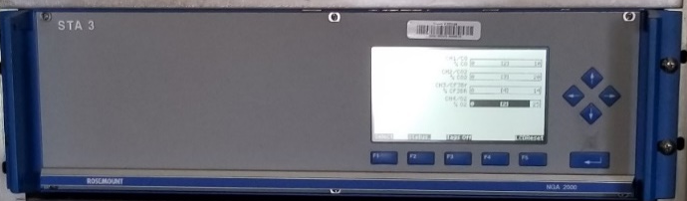
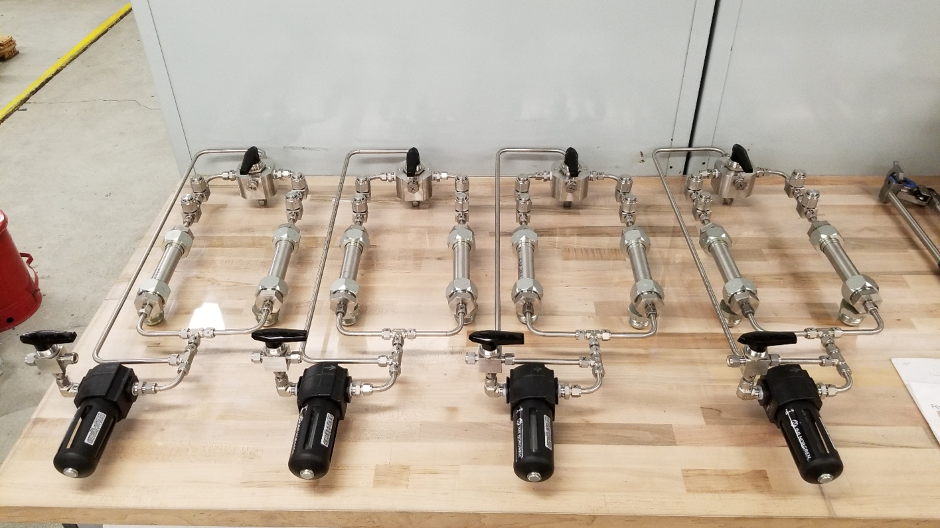
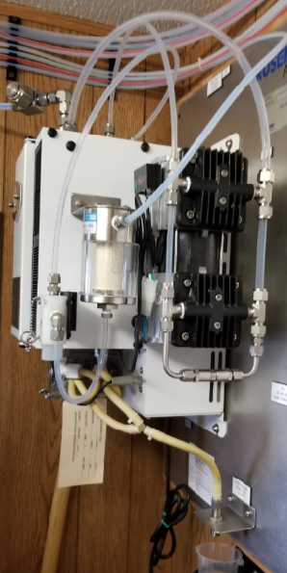
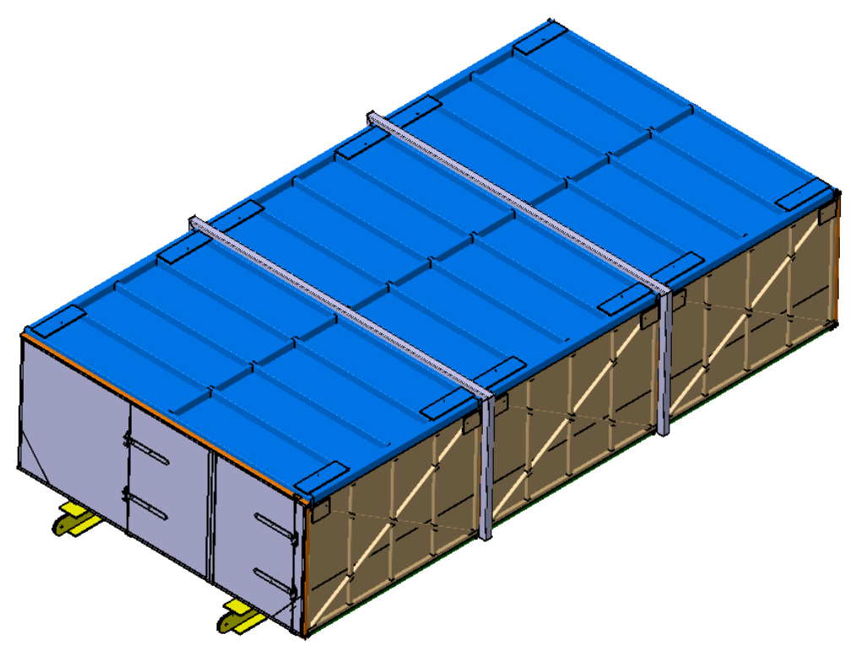
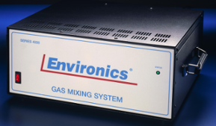
MPS Cell – Permanent Gas Analysis Equipment
Emerson CF₃, CO₂, CO, and O₂ Sensing
Filtration system meticulously replicated per FAA design
Sample Conditioning
Calibration Gas Mixing
MPS Test Fixture
Calibration Gas Tank Array

Slide 17
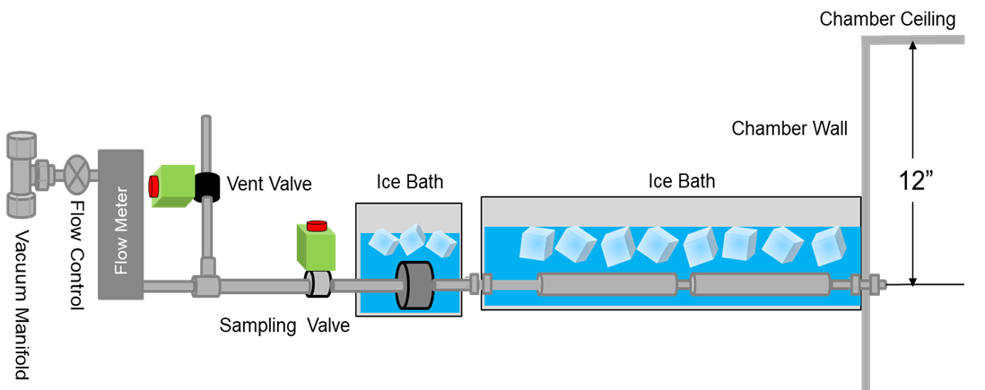
MPS Cell – Detail of Acid Gas Sample Collection
Cooling effluent gases to increase collection efficiency
  Using ice baths on both the collection tubes and the HEPA filters allowed us to protect both our valves and our flow meters from the fire atmosphere
  Opening the sampling valve while the vent valve is still open allowed us to avoid pulling the filter membrane out of the HEPA filter cartridge

Slide 18
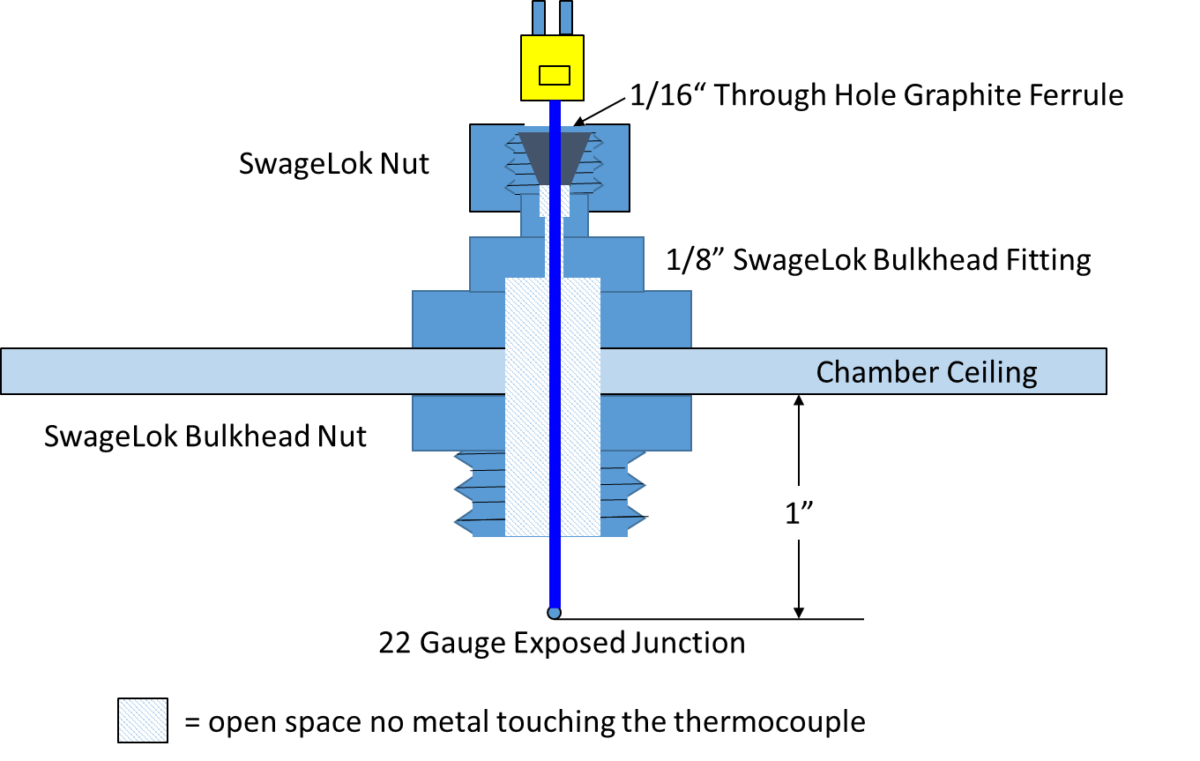
Thermocouple Isolation From Chamber Structure
Proper installation ensures the most consistent results

Slide 19

MPS Cell – Water Suppression System
Valves for each nozzle position allow for water suppression system allows us to extinguish fires without wetting every box thus improving the efficiency of the testing protocol overall
Spray Heads
Drain Down Valve Outlet and Air Purge Control
MPS Test Chamber
Not Subject to EAR or ITAR

Slide 20
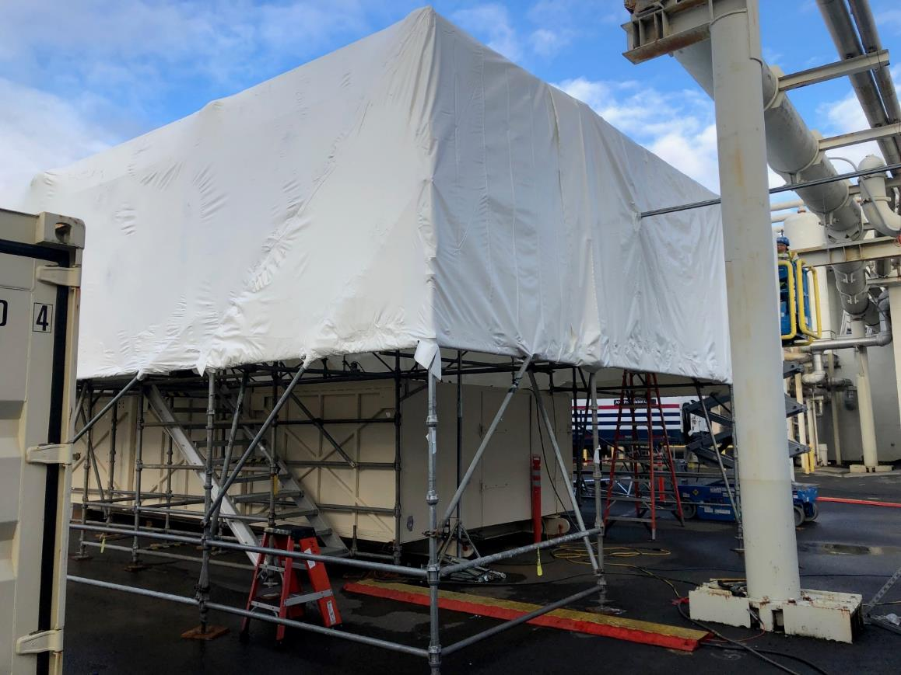
Chamber Installation at the Boeing Hazardous Test Facility

Slide 21
Questions?
Nels A. Olson Ph.D.
nels.a.olson@boeing.com
1-206-643-5040

